Slide 1
Project report
S
N
MAGNETIC
MATERIALS
Prediction of Curie temperature
using Machine Learning

Slide 2
Outline
Plan for today
1. Problem formulation and Motivation | (3-6)
2. Related works | (7)
3. Data preprocessing 3.1 Dataset details 3.2 Preprocessing and generation of descriptors | (8) (9-10)
4. Models descriptions 4.1 Kernel Ridge Regression 4.2 Random Forest 4.3 XGBoost 4.4 LightGBM 4.5 CatBoost 4.6 Model Stacking | (11-12) (13-14) (15-16) (17-18) (19) (20)
5. Summary and Further steps | (19-21)

Slide 3
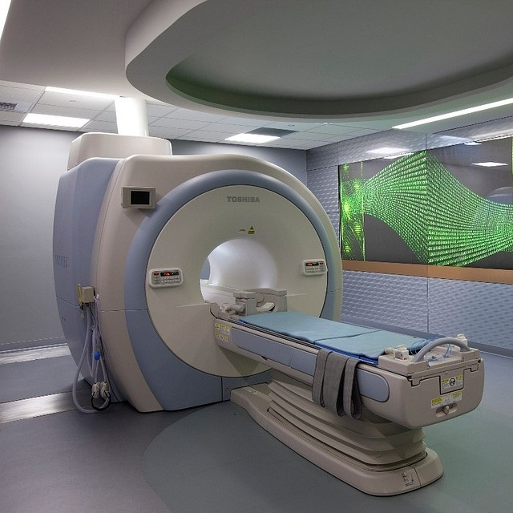



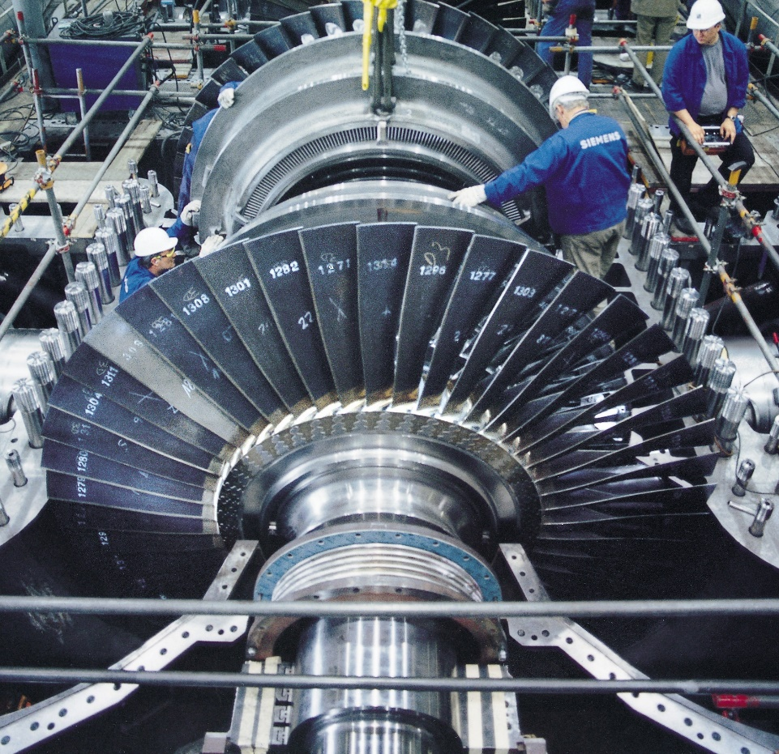
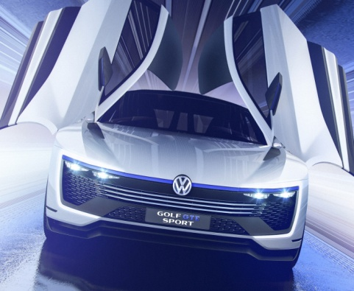

1. Project motivation
Industrial use of magnets
AUTOMOTIVE
INDUSTRY
ENERGY
SYSTEMS
MEDICINE
ELECTRONIC
DEVICES

Slide 4





1. Critical materials
About 90% of all rare earth
elements are produced in China.
Rare Earth Elements mining.
Production volume in thousand tons
3
105
6
1,7
12

Slide 5
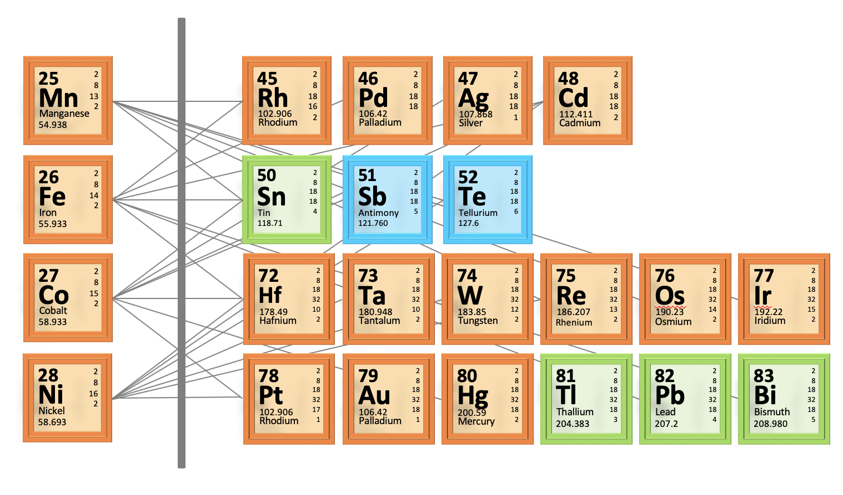

1. Computational search
Searching for a nowel magnetic materials
Typically magnet might be considered as “useful”, only if its Curie temperature is more than 600K
Curie temperature is one of the most important optimization parameters in a computational search for novel magnetic materials.
Unfortunately, all existing modern methods can not exact information about Tc
Computational prediction of new magnetic materials. Saeed Rahmanian Koshkaki, Zahed Allahyari, Artem R. Oganov 2020

Slide 6
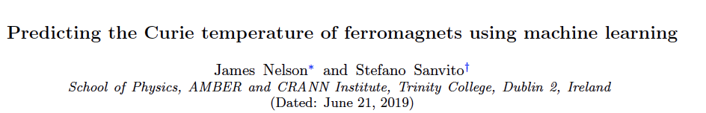
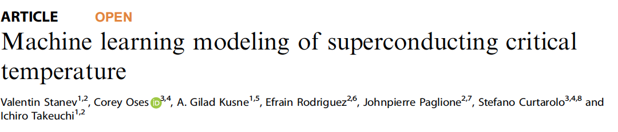
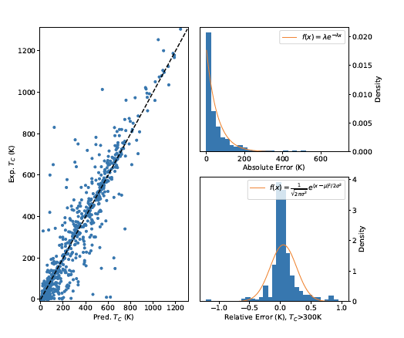
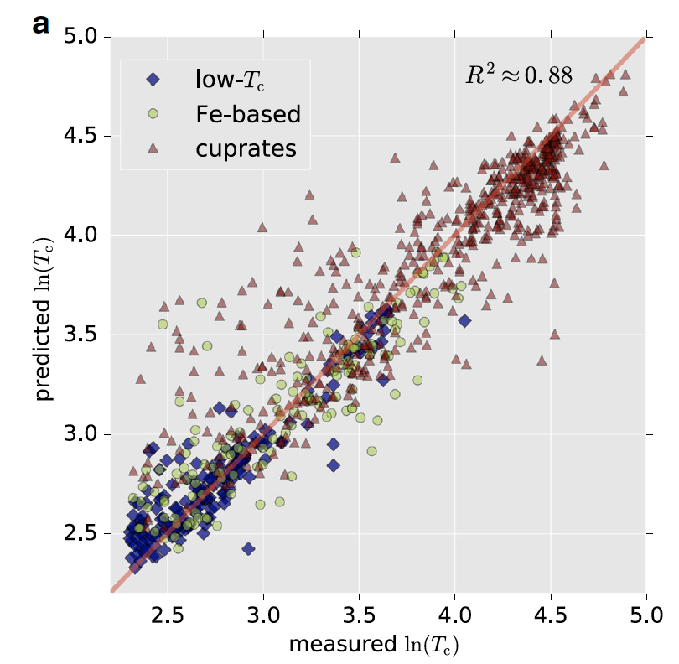
2. Related works
Critical temperatures predictions using Machine Learning
Only Regresion problem
Descriptors based on chemical formula
Small dataset 2750 samples
Best score 0.81
RF model
Regresion and classification problems
Descriptors based on chemical formula
>12 000 Samples in Dataset
Best R² score 0.88
RF model

Slide 7
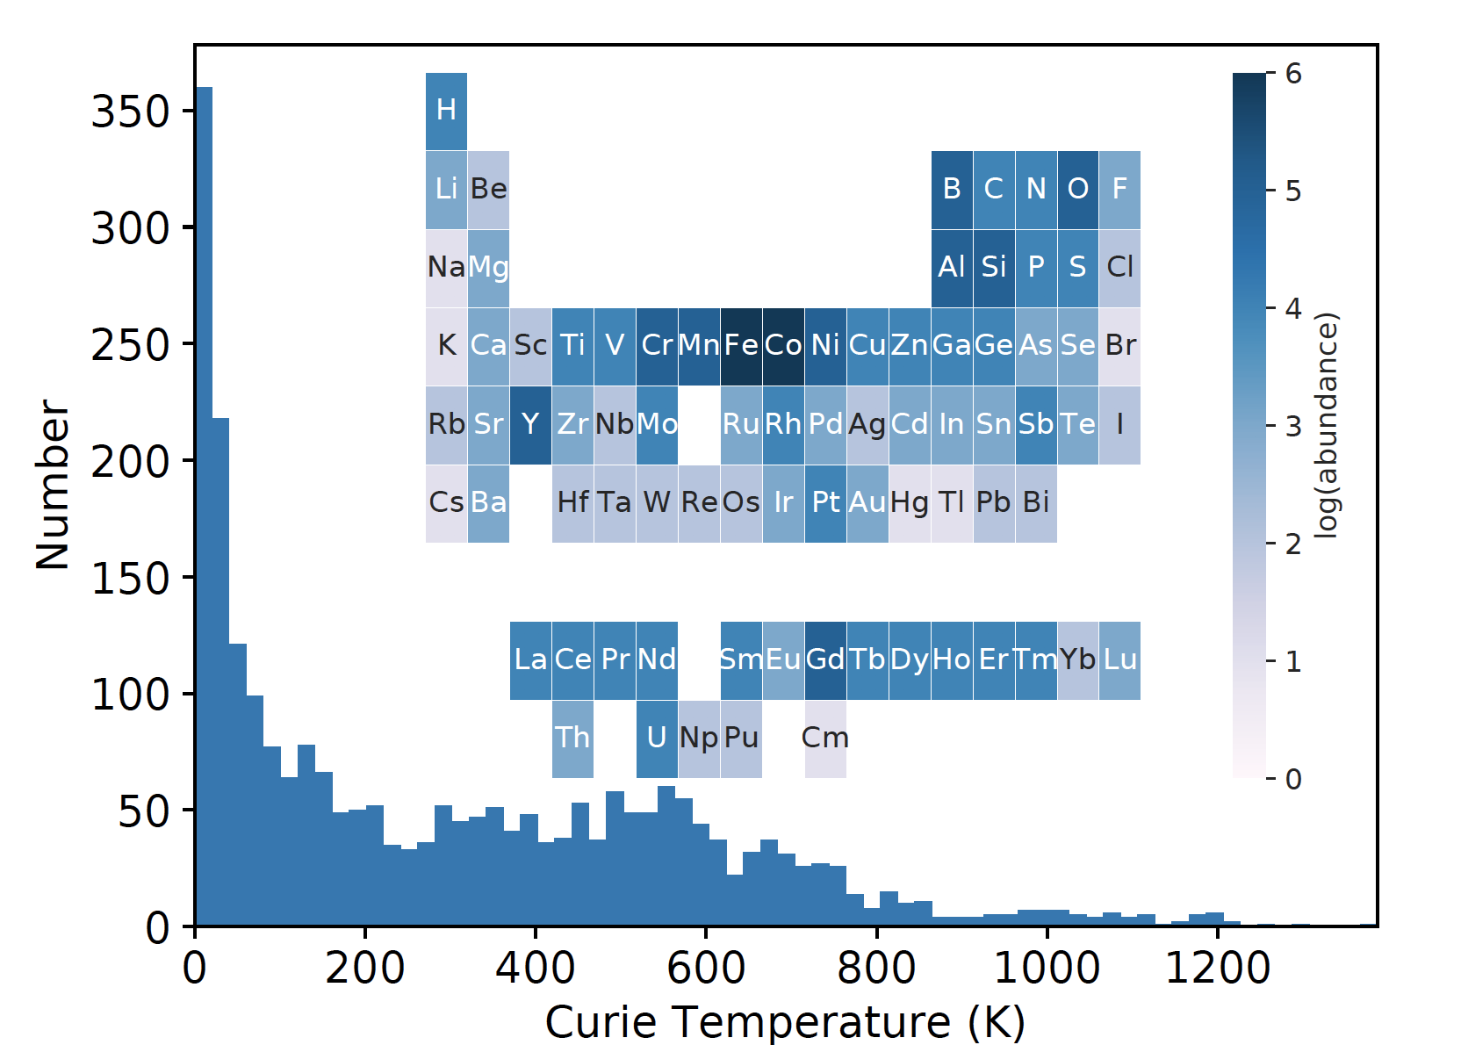
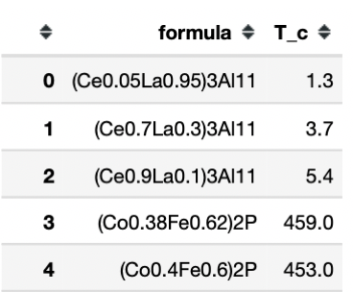
3.1 Dataset details
Critical magnetic temperature experimental data
5091 samples from experimental data
2557 samples after dropping of duplicates
Only chemical formula and Curie Temperature

Slide 8
3.2 Dataset preprocessing
Data cleaning and generation of the descriptors
Attributes which might basically determined from the periodic law
Electronic structure attributes, which are the fraction of electrons from the 𝑠,𝑝,𝑑 and 𝑓 shells
For all descriptors from the first and second category applied statistics functions
1. Atomic Weight
2. Number
3. Column
4. Row
5. Covalent Radius
6. Electronegativity
7. Bandgap
8. Magmom
9. MeltingT
10. Mendeleev Number
11. Space Group
12. Volume
1. N Unfilled
2. N Valence
3. N d Unfilled
4. N d Valence
5. N f Unfilled
6. N f Valence
7. N p Unfilled
8. N p Valence
9. N s Unfilled
10. N s Valence
1. minimum
2. maximum
3. range
4. mode
5. mean
6. mean
abs. dev.
215
V_{chem}
Total dimension of descriptors
[1] Ward, Logan et al. “A General-Purpose Machine Learning Framework for Predicting Properties of Inorganic Materials.” Computational Materials 2.1 (2016)
[2] L., Dunn, A., Faghaninia, A., Zimmermann, N. E. R., Bajaj, S, Matminer: An open source toolkit for materials data mining. Comput. Mater. Sci. 152, 60-69 (2018).

Slide 9
3.2 Models Validation
Train/Test split + Cross Validation
Final model evaluation
Test Set
843 samples
Trained
model
Full Dataset
2557 samples
Train Set
1714 samples
10 fold cross validation for hyperparameters tuning

Slide 10
4.1 Kernel Ridge Regression
Model tuning and final perfomance
Metrics | Linear | Polynomial | RBF | Laplacian
R² (test) | 0.616 | 0.759 | 0.756 | 0.793
R² (cross.val) | 0.601 | 0.768 | 0.754 | 0.787
RMSE (K) | 161.9 | 131.4 | 132.3 | 121.7
Max Error (K) | 598.1 | 783.4 | 795.6 | 642.05

Slide 11
4.2 Random Forest Regressor
Ensemble of trees = Random Forest
Basics of the alghoritm
Tree model
Bootsrapping
=
Random subset of samples
+
Random subset features

Slide 12
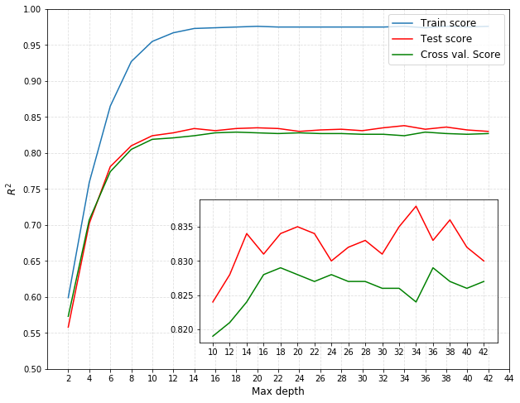
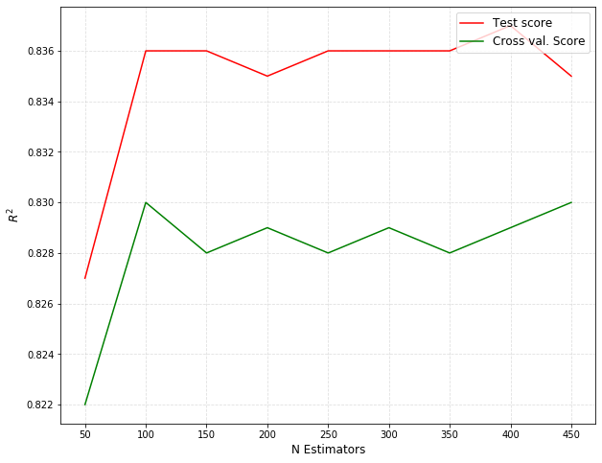
4.2 Random Forest Regressor
Hyperparameters tuning and model perfomance
Tree depth optimization
Number of Trees optimization
Metrics | All
R² (test) | 0.837
R² (cross.val) | 0.859
RMSE (K) | 101.04
Max Error (K) | 468.08

Slide 13
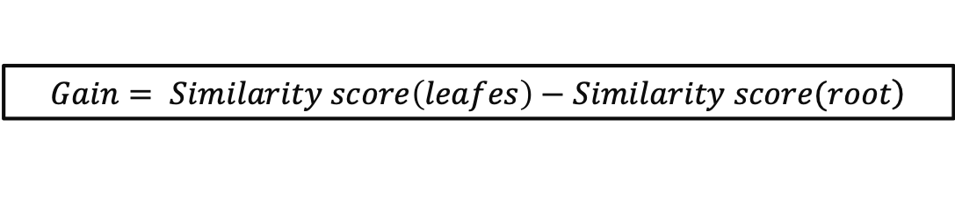
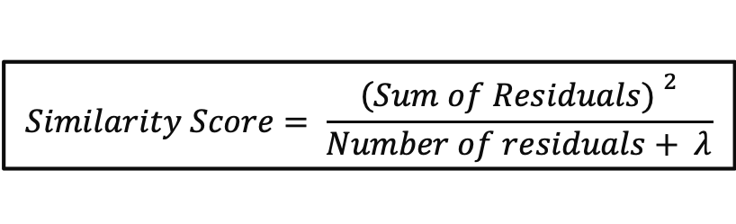
4.3 XGBoost
Basics of alghoritm
1st leaf
Initial Guess
a
a
$$Similarity Score= \frac{{\left(Sum of Residuals) \right.}^{2}}{Number of residuals+ λ}$$
a
$$\left.Gain= Similarity score\left(leafes\right)−Similarity score(root\right)$$

Slide 14
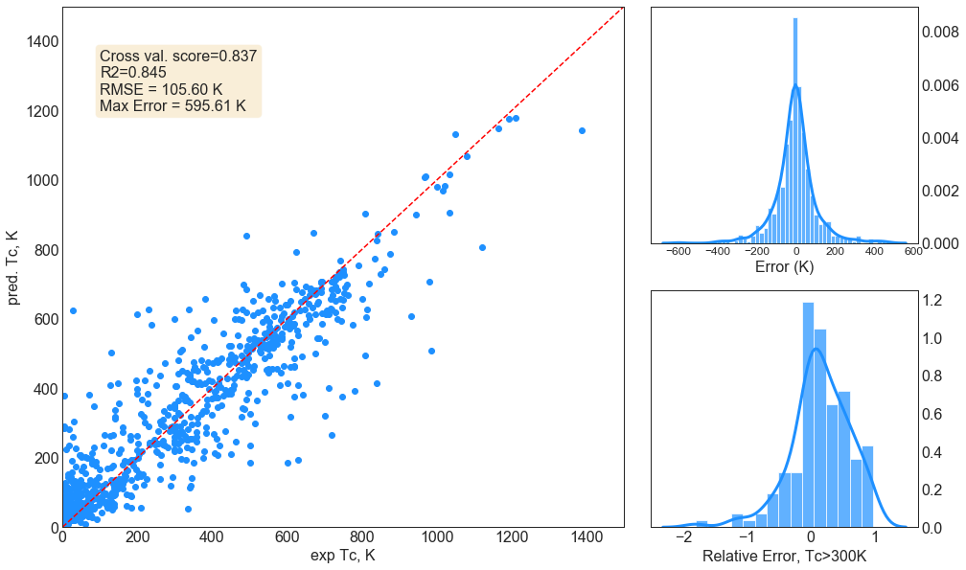
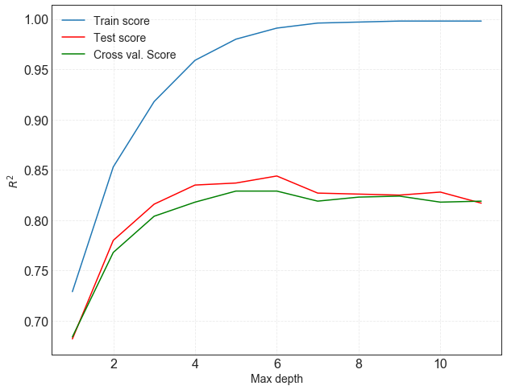
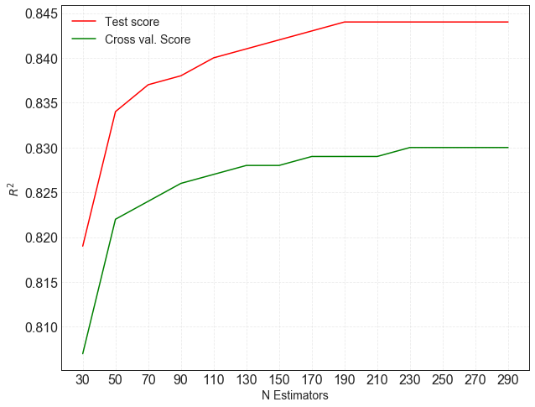
4.3 XGBoost
Hyperparameters tuning and model perfomance
Tree depth optimization
Number of Trees optimization
Metrics | Score
R² (test) | 0.839
R² (cross.val) | 0.878
RMSE (K) | 93.85
Max Error (K) | 463.34

Slide 15
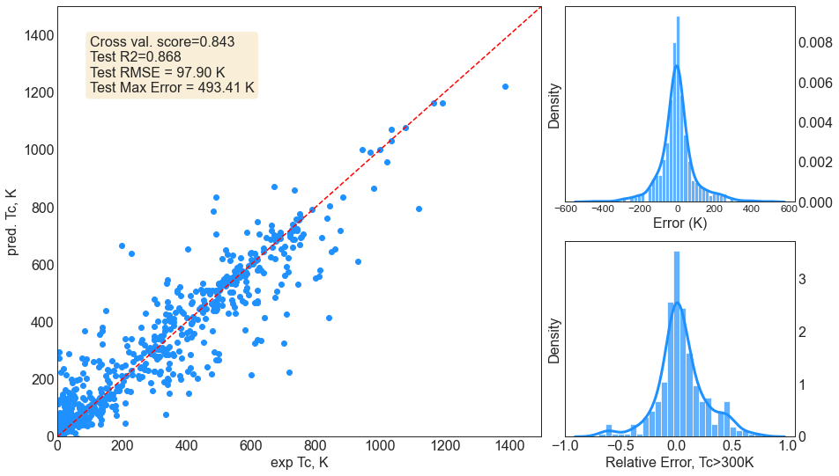
4.4 LightGBM
Hyperparameters tuning and model perfomance
param_grid_lgb = {
'learning_rate' : [0.01, 0.1],
'n_estimators’ : [500, 1000, 1500],
'max_depth’ : [10, 20],
'num_leaves’ : [100]
}
Metrics | Score
R² (test) | 0.843
R² (cross.val) | 0.868
RMSE (K) | 97.90
Max Error (K) | 493.41

Slide 16
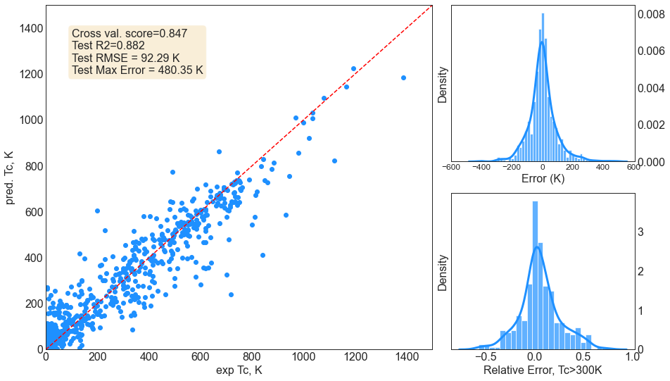
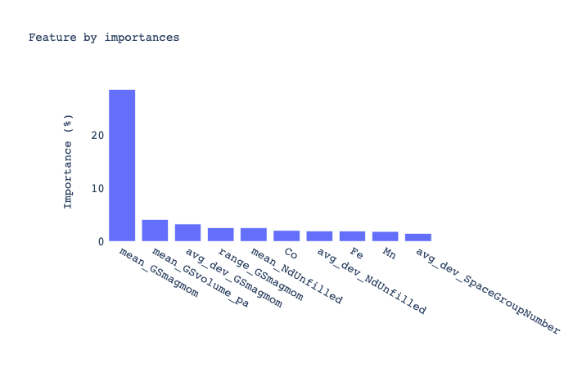
4.5 CatBoost
Model perfomance
Metrics | Score
R² (test) | 0.847
R² (cross.val) | 0.882
RMSE (K) | 92.29
Max Error (K) | 480.35
Notes:
N

Slide 17
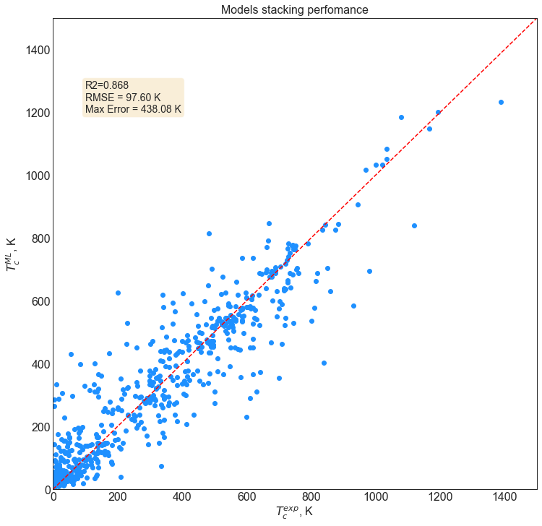
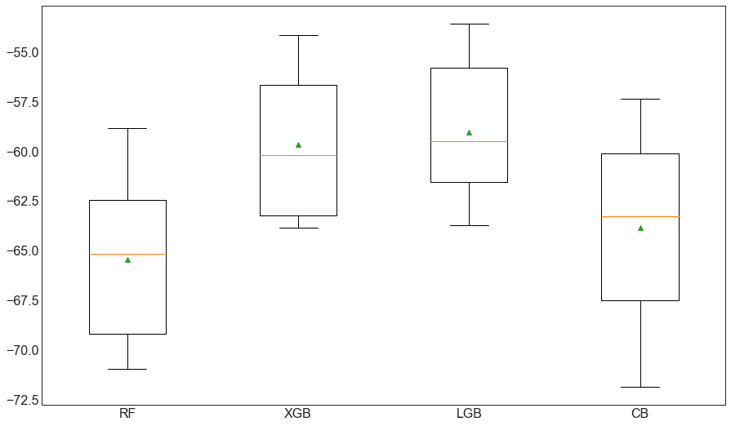
4.6 Models Stacking
Model perfomance
A box-and-whisker plot is then created comparing the distribution negative MAE scores for each model.
level 0
y₁(x)
Random forest
level 1
y₂(x)
y(y_{1,} y_{2,} y_{3,} y₄)
XGBoost
y₃(x)
Random forest
LightGBM
y₄(x)
CatBoost

Slide 18
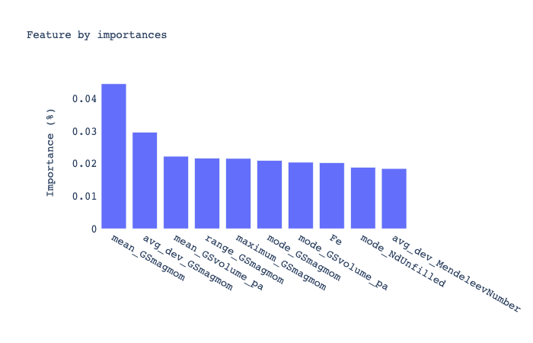
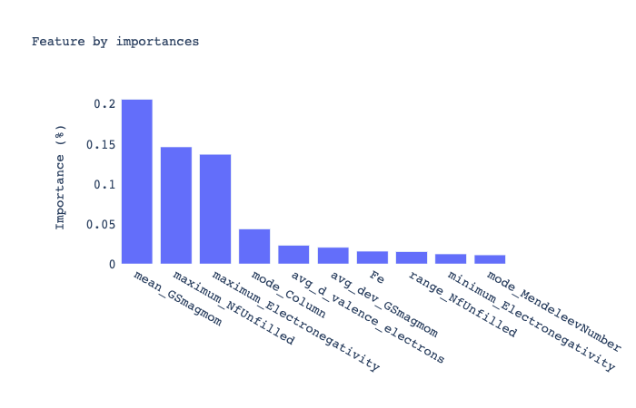
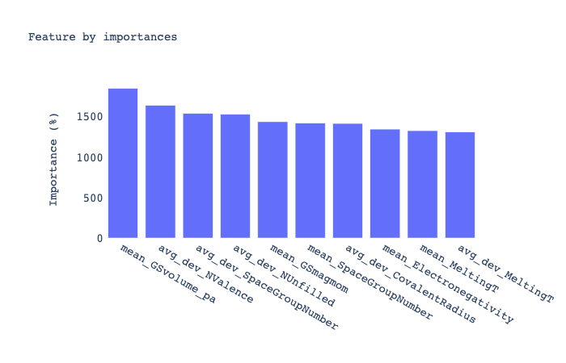
5. Feature Importance
Physical insights from trained models
RandomForest
XGBoost
LightGBM
CatBoost

Slide 19
5. Summary of the best models
All the results on a single slide
Metrics | KRR | RF | XGB | LGB | CB | RF(ref.) | KRR(ref)
R² (test) | 0.796 | 0.837 | 0.839 | 0.843 | 0.847 | 0.87 | 0.72
R² (cross.val) | 0.818 | 0.859 | 0.878 | 0.868 | 0.882 | 0.81 | -
RMSE (K) | 114.73 | 101.04 | 93.85 | 97.90 | 92.29 | 57 | -
Max Error (K) | 637.59 | 468.08 | 463.34 | 493.41 | 480.35 | - | -

Slide 20
5. Futher steps
Possibilites for this project
What can be done next:
Split the problem into the classification and regression (medium)
Increase the size of the dataset (hard)
Include structural information (serious drawback) (hard)

Slide 21




Meet Our wonderful team
Faridun Jalolov
Olajide Olubovale
Opeyemi Isaac
Dmitry Volkov

